Slide 1
The Federal Budget -
Appropriations Process:
NCA Government Affairs

Slide 2
Agenda
Learn more about the congressional budget and annual appropriations process.
Understand how congressional appropriations impact our CACs – specifically through the Commerce, Justice, Science budget.
Be more comfortable speaking with your board, colleagues and congressional offices about annual appropriations and CAC funding.

Slide 3
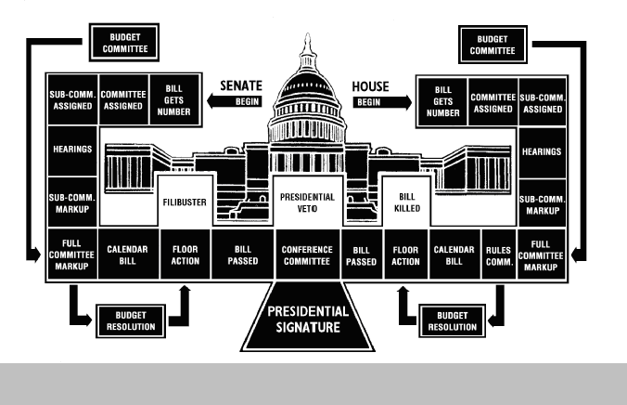
The Legislative Process

Slide 4
Introduction
U.S. Constitution gives Congress authority over all appropriations measures.
Article 1, Section 9 states: “No money shall be drawn from the Treasury, but in Consequence of Appropriations made by Law…” (This is known as the power of the purse.)
Under law, public funds may only be used for the purposes for which Congress appropriated the funds.

Slide 5
Introduction
Every year, Congress considers 12 appropriations bills, which provide funding for all federal agencies and programs.
The House and Senate Appropriations Committees each have 12 subcommittees and each subcommittee has jurisdiction over one regular annual appropriations bill.
Appropriations funding generally expires at the end of the federal fiscal year – September 30.

Slide 6
Introduction - Continued
Every year, Congress considers 12 appropriations bills, which provide funding for all federal agencies and programs.
The House and Senate Appropriations Committees each have 12 subcommittees and each subcommittee has jurisdiction over one regular annual appropriations bill.
Appropriations funding generally expires at the end of the federal fiscal year – September 30.

Slide 7
Appropriations Subcommittees
Agriculture, Rural Development, Food and Drug Administration
Commerce, Justice, Science (NCA/CACs are funded here)
Defense
Energy and Water Development
Financial Services and General Government
Homeland Security
Interior
Labor, Health and Human Services, Education (Additional child welfare funding available here)
Legislative Branch
Military Construction, Veterans Affairs
State, Foreign Operation
Transportation, and Housing and Urban Development

Slide 8
The Annual Appropriations/Budget Cycle
The President starts the budget cycle by submitting his proposals in February. (President’s budget comes out Feb. 9th.)
The President’s submission recommends (suggests) program spending levels in the form of budget authority (BA). Budget authority does not represent cash to agencies.
Appropriations bills are the only legal authority for the federal government to make payments from the Treasury.

Slide 9
Congressional Budget Committees
Congress takes the President’s budget proposal and develops its own budget in the form of a budget resolution that spells out funding for 5 (or 10) years.
However, when the Appropriations Committees receive their spending allocations from the budget resolution – they are for the upcoming fiscal year only.
The timing of the various stages of the appropriations process tends to vary from year to year.

Slide 10
Work of the Appropriations Committee
In spring, the Appropriations subcommittees hold hearings on program spending.
Generally, by May or June, both chambers begin drafting and reporting the 12 individual appropriations bills, sending them to the floor for consideration.
During the fall and winter, the appropriations committees are usually heavily involved in negotiations to resolve differences between the different versions of annual appropriations bills.

Slide 11
Floor Action for Appropriations Bill
The House passes a rule setting the parameters of the debate.
The Senate sets up debate by unanimous consent.
Normally, rules for appropriations bills are “open”, meaning that there is no set limit on the number of amendments that may be offered/considered.
However, amendments must: be germane, cannot legislate and cannot exceed the ceiling for spending.
If an amendment violates any of these rules, any House member may raise a point of order, effectively killing the amendment.

Slide 12
House and Senate Conference Action
Differences in appropriations bills are resolved through a conference report or through an exchange of amendments.
The conferees generally do not have authority to change provisions that both chambers previously included in their respective bills or add new items. (If new items not previously considered are added, a point of order may be raised when the conference report is brought back to the respective chambers.)

Slide 13
Regular Appropriations Bills
Regular appropriations bills provide most funding.
The Appropriations Committees will provide more detailed directions for federal spending through report language.
Appropriations bills may also provide transfer authority, which allows agencies to shift funds from one account to another. However, agencies cannot make these types of transfers unless first authorized by Congress.
On the other hand, agencies may generally shift funds within the account without congressional authorization.

Slide 14
Omnibus/Continuing Resolutions
Omnibus appropriations bills are measures that combine several appropriations bills together.
Packaging appropriations bills into fewer bills allow for Congress and the President to resolve outstanding issues more quickly.
Regular appropriations expire at the end of the fiscal year - Sept. 30. If no action on one or more regular appropriations bills has taken place by Oct. 1, the agencies funded must cease activities due to the lack of budget authority. (Some activities are exempted – such as security-related funding.)

Slide 15
Discretionary vs. Mandatory Spending
Federal spending is divided into 2 categories: discretionary and mandatory (direct) spending.
Discretionary spending (such as funding for the Victims of Child Abuse Act and other DOJ programs) is controlled by the House and Senate Appropriations Committees through the appropriations process – meaning the Appropriations Committees have discretion on program funding from year to year.
Mandatory (direct) spending is predominantly for entitlement programs. The appropriations committees have limited control over funding for entitlements – since the amount was previously agreed to and enacted into law.

Slide 16
Authorization vs. Appropriations
Authorization bills are measures that establish, continue, or modify federal agencies or programs.
An authorization measure will establish funding levels for programs – including in any limits or ceilings.
For example, the Victims of Child Abuse Act is an authorization bill passed through of the Judiciary Committees.
Authorization bills will specify funding levels, but these programs will not actually receive funding until they are included in an appropriations bill.

Slide 17
Questions?
Any questions?

Slide 18
Contact Information
Denise Edwards
NCA Director of Government Affairs
dedwards@nca-online.org or 202-548-0090 ext. 103
Will Laird
NCA State Government Affairs Officer
wlaird@nca-online.org or 202-548-0090 ext. 119

